Slide 1
Capacitor
“The storage of an electrical part”

Slide 2
In the beginning:
In 1745 a new physics and mathematics professor at the University of Leyden (spelled Leiden in modern Dutch), Pieter van Musschenbroek (1692 - 1791) and his assistants Allmand and Cunaeus from the Netherlands invented the 'capacitor' (electro-static charge or capacitance actually) but did not know it at first.
His condenser was called the 'Leyden Jar' (pronounced: LY'duhn) and named so by Abbe Nollet.
This Leyden jar consisted of a narrow-necked glass jar coated over part of its inner and outer surfaces with a conductive metallic substance; a conducting rod or wire passes through as insulating stopper (cork) in the neck of the jar and contacts the inner foil layer, which is separated from the outer layer by the glass wall.
The Leyden jar was one of the first devices used to store an electric charge. If the inner layers of foil and outer layers of foil are then connected by a conductor, their opposite charges will cause a spark that discharges the jar.
Actually, van Musschenbroek's very first 'condenser' was nothing more than a beer glass!

Slide 3
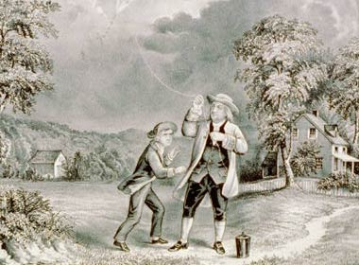
The storage continues:
Benjamin Franklin was acquainted with the Leyden Jar experiments also so he decided to test his ideas that 'charge' could also be caused by thunder and lightning.
Franklin tested his theories, in Philadelphia in June 1752, via his now famous 'Electrical Fluid Theory' to prove that lightning was an electrical phenomenon.
What he did was fly a kite which had a metal tip. The kite was tied with wet conducting thin hemp cord and at the end he attached a metal key to which a non-conducting silk string was attached which he held in his hand; when he held his knuckles near the key he could draw sparks from it.
Although his experiment was completed successfully and the results as he had calculated before, the next couple people after him who tried the hazardous experiment were killed by lightning strikes

Slide 4
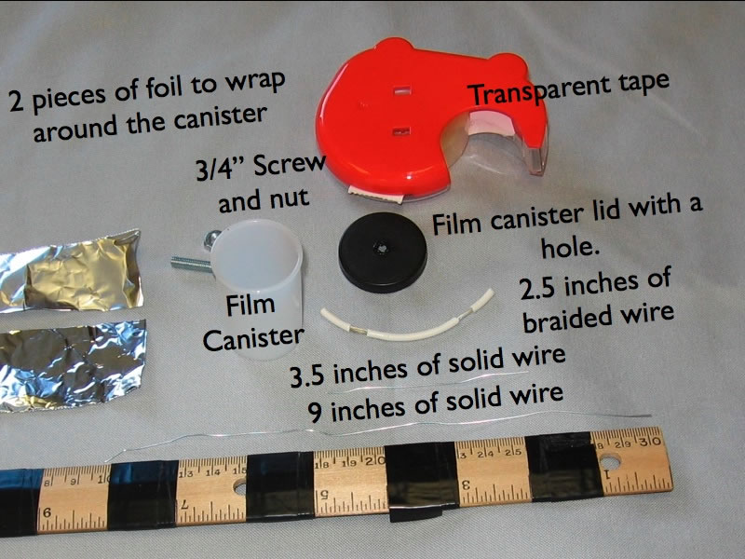
Make your own Leyden jar
Materials needed:
Film Canister
Aluminum Foil
Bare Copper Wire
Braided wire
Transparent tape
¾” bolt and nut
http://www.mrwaynesclass.com/ap/capacitance/MakeYourOwn/index.htm

Slide 5
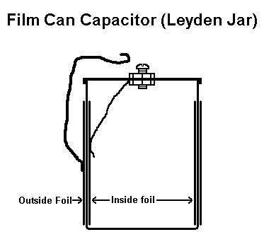
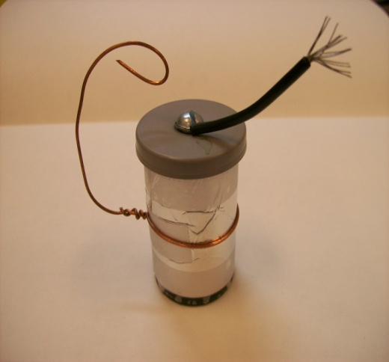
Assembly:
These websites will also assist in making a film canister Leyden Jar:
http://www.mrwaynesclass.com/ap/capacitance/MakeYourOwn/index.htm
http://home.earthlink.net/~lenyr/stat-gen.htm
http://forevergeek.com/articles/instructions_for_making_a_film_canister_leyden_jar.php

Slide 6
So what is a Capacitor?
A Capacitor's Description:
A capacitor consists of two or more plates of a conductive material separated by an insulating substance called a dielectric. A dielectric may be solid, gel, liquid, or gas. A capacitor's ability to store energy is measured in either microfarads (uF), nanofarads (nF), or picofarads (pF). Micro means one millionth, nano stands for one billionth, and pico for on trillionth (farads are also used, but in high voltage work they are impractically large units). Several factors affect capacitance. The formula for determining capacitance is: C = ε (A/d) Where C is the capacitance in picofarads, Permittivity (ε) is a measure of the ability of a material to be polarized by an electric field., A is the area of one conductive plate in square inches, d is the separation between adjacent plates in inches. As you may know, different insulators have different dielectric constants.

Slide 7
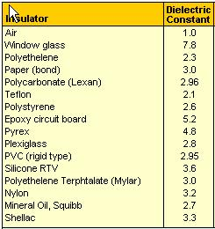
Little more on dielectric constant
The dielectric constant (k) of a material is the ratio of its permittivity ε to the permittivity of vacuum εo, so k = ε/εo. The dielectric constant is therefore also known as the relative permittivity of the material. Since the dielectric constant is just a ratio of two similar quantities, it is dimensionless.
Given its definition, the dielectric constant of vacuum is 1. Any material is able to polarize more than vacuum, so the k of a material is always > 1. Note that the dielectric constant is also a function of frequency in some materials, e.g., polymers, primarily because polarization is affected by frequency.
A low-k dielectric is a dielectric that has a low permittivity, or low ability to polarize and hold charge. Low-k dielectrics are very good insulators for isolating signal-carrying conductors from each other. Thus, low-k dielectrics are a necessity in very dense multi-layered IC's, wherein coupling between very close metal lines need to be suppressed to prevent a degradation in device performance.
A high-k dielectric, on the other hand, has a high permittivity. Because high-k dielectrics are good at holding charge, they are the preferred dielectric for capacitors. High-k dielectrics are also used in memory cells that store digital data in the form of charge.
The formula for determining capacitance is:
C=(0.224kA/d)(n-1)
*n is the number of plates

Slide 8
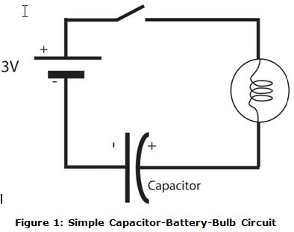
Understanding the Capacitor activity
Materials needed:
Battery Board
Alligator Leads
Capacitor
Aluminum Foil
Transparency film
Catalog Sheets
Multi-meter
Scissors
Heavy Item (Book)
3V bulb
Ruler
Print the following lab activity before you begin: Capacitor Lab

Slide 9
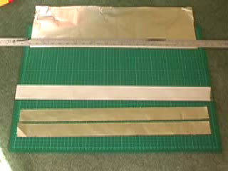
Making your own Capacitor
Two metal plates
Separated by insulating material
‘Sandwich’ construction
‘Swiss roll’ structure
Click for video instructions
Video segment from fizzicsorg ‘s Channel on YouTube

Slide 10
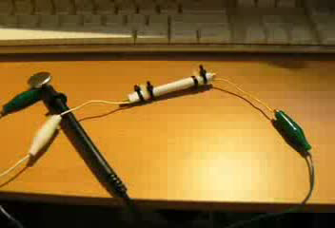
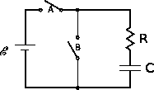
How to charge your Homemade Capacitor
Charging a capacitor is like compressing an electrical spring - the charges on each side of the capacitor repel each other. If the potential difference were removed, they would push the system back toward its uncharged equilibrium state. The work done in charging a capacitor is stored as electric potential energy.
Consider the RC circuit shown below. Imagine that switch A is closed (connected) and switch B is open. Then, charge will move around the circuit until the capacitor is fully charged (i.e. until q = CV). If switch A is opened at this point and switch B is closed, the capacitor will discharge through the resistor until there is no net charge on either of its plates.
Click to play video
An RC circuit. With switch A closed and switch B open, the capacitor is charged through the resistor by the power source. With switch A open and switch B closed, the capacitor discharges through the resistor.
Homemade Paper Capacitor being charged and discharged

Slide 11
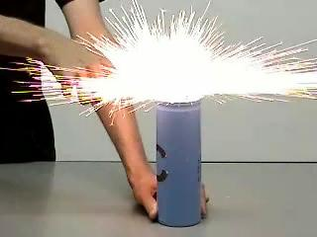
Summary
Many aspects of the “Capacitor” have been covered in this activity. This is just a prelude to other activities and knowledge that can be gained about this electronic component. Care should be taken when making or handling any capacitor, as injury from electrical shock is always a possibility.

Slide 12
Resources:
http://www.uoguelph.ca/~antoon/gadgets/caps/caps.html - nice historical and informative web site on the capacitor.
http://forevergeek.com/articles/instructions_for_making_a_film_canister_leyden_jar.php - leyden jar film canister assembly.
http://www.mrwaynesclass.com/ap/capacitance/MakeYourOwn/index.htm -all picture assembly of film canister leyden jar assembly.
http://www.uoguelph.ca/~antoon/circ/hv/hvcap/hvcap.html - good page for beginning to understand capacitors
http://fizzics.org/capacitor.aspx - understanding parallel plate capacitors
http://ocw.mit.edu/OcwWeb/hs/physics/k/2/2.htm - MIT open classroom site Capacitors
http://www.matter.org.uk/Schools/Content/Capacitors/Default.htm -Excellent java enabled website where you complete a capacitor lab online.
http://www.hanssummers.com/radio/homebrew/capacitor/index.htm - other attempts at making homemade capacitors from simple materials.

